Slide 1
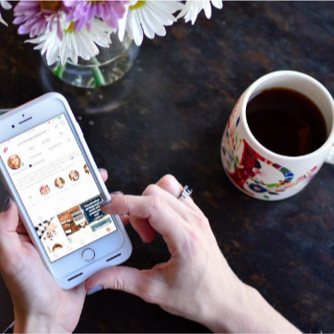
Care Partner Connect

Slide 2
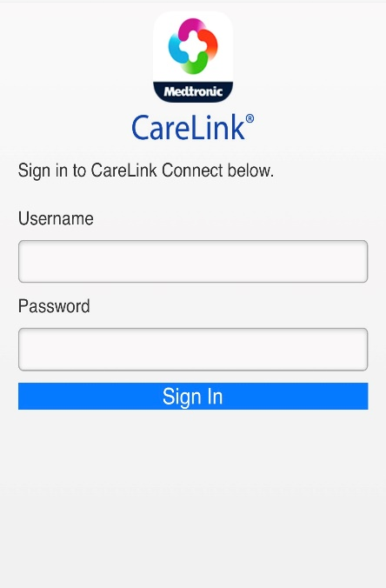
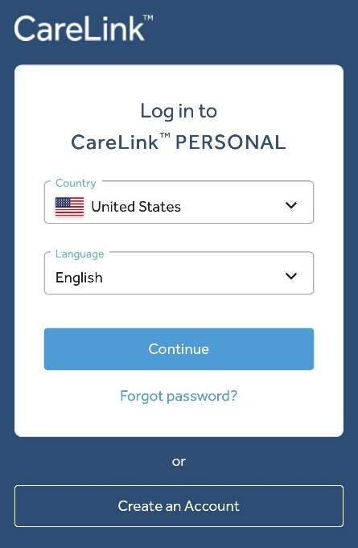
CareLink personal 14.0
New care partner functionality
Improving Care Partner registration
  Previously, Care Partners could only register themselves through the Guardian Connect App.
  Previously, Care Partners had to wait for the patient to initiate a data sharing request.
  Now, they are able to proactively request sharing with a patient.
  Now, Care Partners can create an account in CareLink Personal and initiate data sharing request with a patient if they know their username.
New landing page via smartphone browsers
Previously:
  Navigating to carelink.minimed.com would take you to CareLink™ Connect landing page.
Now:
  Navigating to carelink.minimed.com will take you to the mobile web application. Care Partners log in here to see the CareLink™ Connect screen.

Slide 3
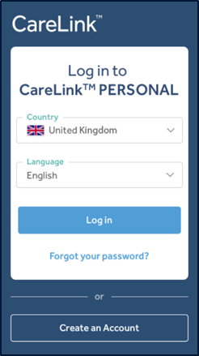
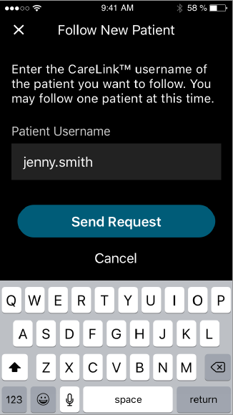
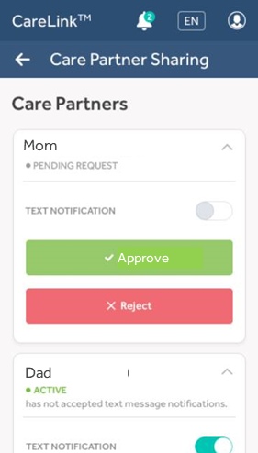
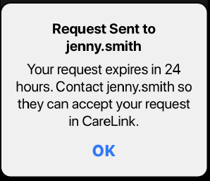

CareLink Personal 14.0 - Care partner registration & ACCESS
OLD WAY - tedious
    OLD
1 Patient creates CL account, if none prior | 2 Patient creates ID + temp PWD for Partner | 3 Patient informs partner of ID + tPWD | 4 Partner logs on CL-site w/ ID + tPWD | 5 Partner creates new account on CL-site | 6 Partner changes PWD (ID permanent) | 7 CareLink sends access request to patient | 8 Patient grants access to Partner | Patient repeats 1-7 for every new Partner (up to 5)
NEW WAY - streamlined
    NEW
1 Patient creates account on CL-site, if none prior | 2 Partner creates new account on CL-site, including ID + PWD | 3 CareLink sends access request to patient by entering patient ID | 4 Patient grants access to Partner | Patient repeats step 4 only for every new Partner (up to 5 followers)

Slide 4
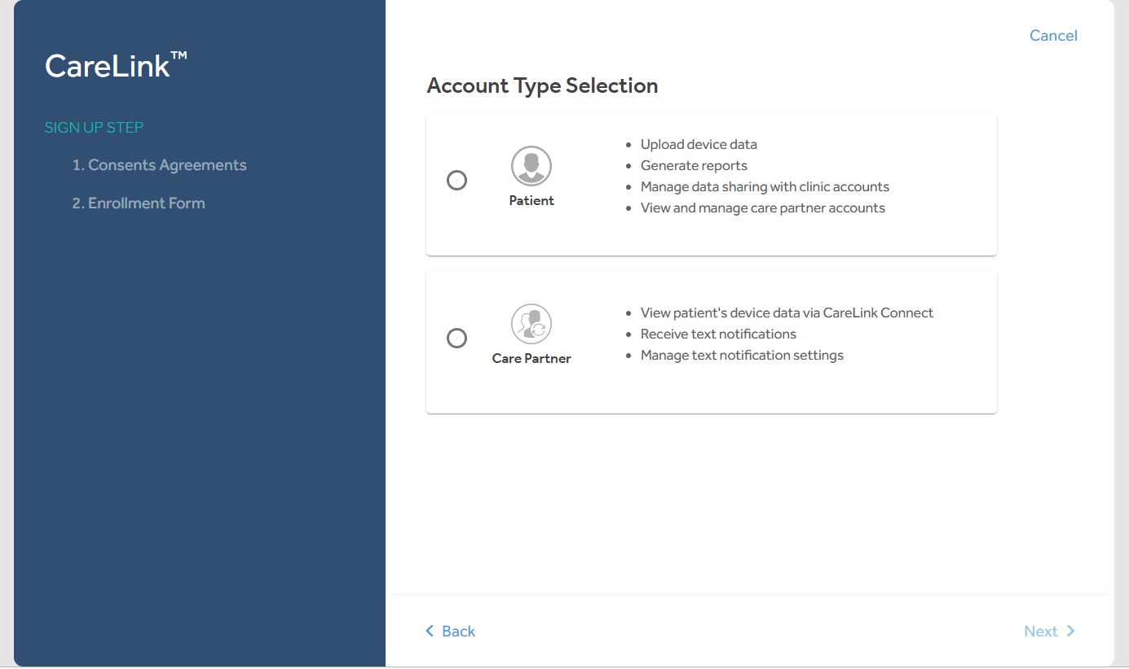
CareLink Personal 14.0 - Care partner registration & ACCESS
Care Partners can register through CareLink™ Personal website

Slide 5
CareLink Personal 14.0 - Care partner registration & ACCESS
Care Partner then does the below the same as a patient account set up
  Goes through consents
  Selects Username and Password
  Registers email

Slide 6
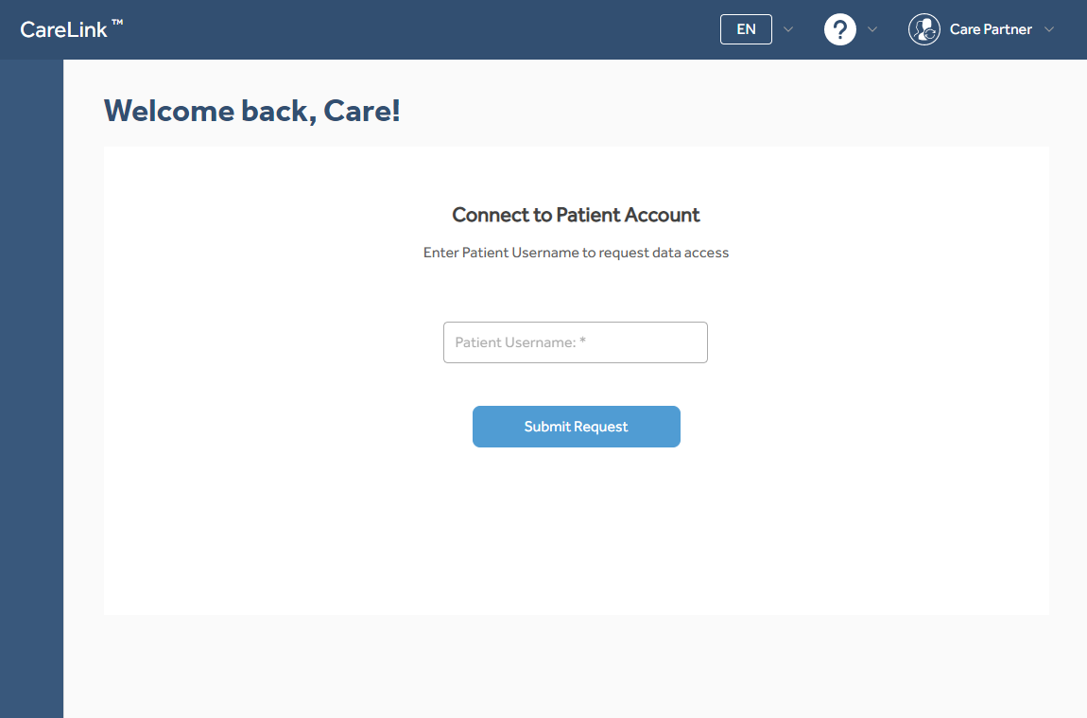
CareLink Personal 14.0 - Care partner registration & ACCESS
Care Partners login & request linking with patient

Slide 7
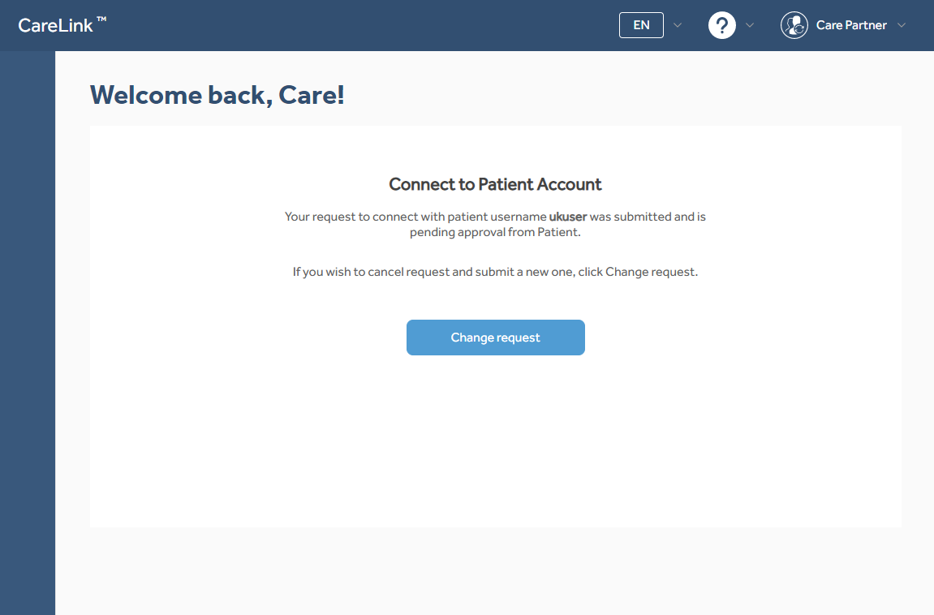
CareLink Personal 14.0 - Care partner registration & ACCESS
Linking request sent – Patient account will receive an email notification

Slide 8
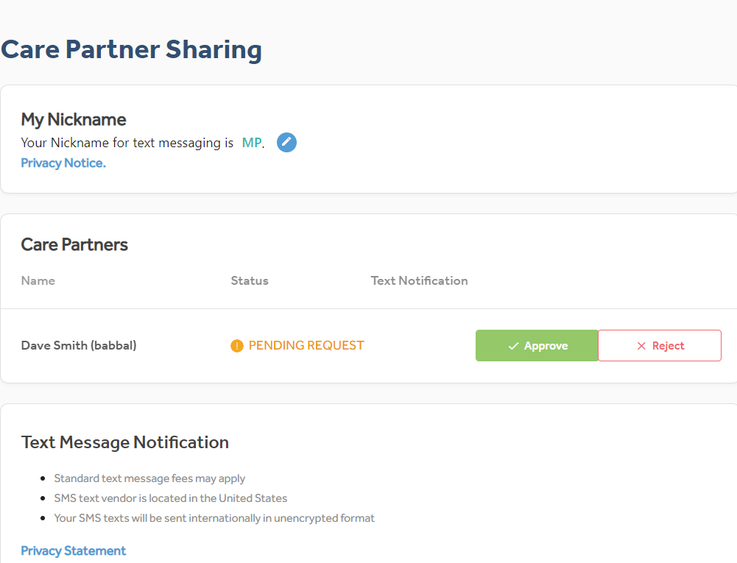

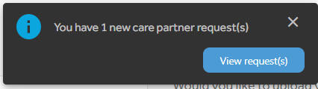
Patient Then approves or Rejects request
Patient Account will have a notification

Slide 9
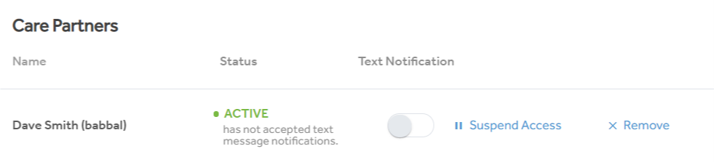
Patient Options once Linked

Slide 10
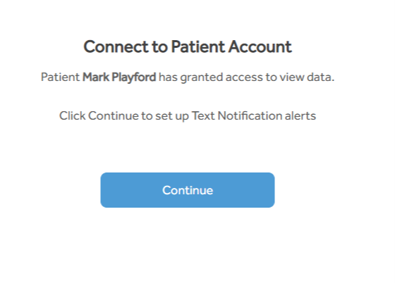
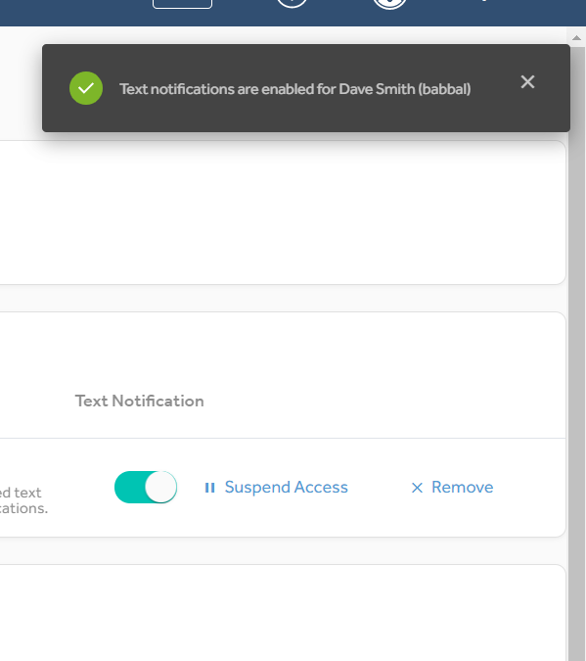
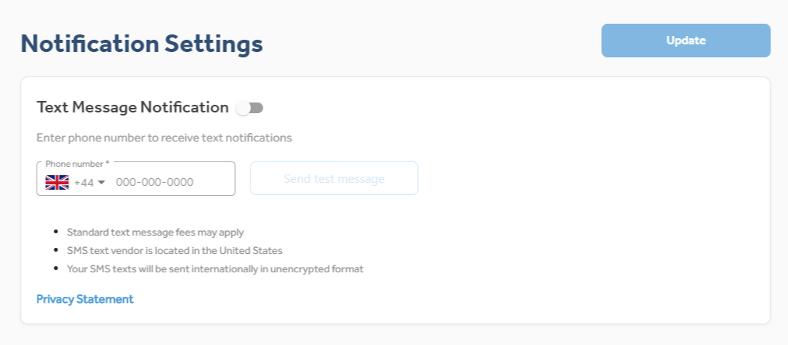
To Activate SMS Alerts
Care Partner Logs in to confirm acceptance

